Slide 1

















Ch3: Transport Layer
application
transport
network
data link
physical
provide logical communication between app processes running on different hosts
transport protocols run in end systems
send side: breaks app messages into segments, passes to network layer
rcv side: reassembles segments into messages, passes to app layer
more than one transport protocol available to apps
Internet: TCP and UDP
logical end-end transport
application
transport
network
data link
physical

Slide 2
Internet transport-layer protocols
reliable, in-order delivery (TCP)
congestion control
flow control
connection setup
unreliable, unordered delivery: UDP
no-frills extension of “best-effort” IP
services not available:
delay guarantees
bandwidth guarantees
application
transport
network
data link
physical
network
data link
physical
network
data link
physical
network
data link
physical
logical end-end transport
network
data link
physical
network
data link
physical
network
data link
physical
network
data link
physical
application
transport
network
data link
physical

Slide 3
Connectionless demultiplexing
UDP socket identified by two-tuple (not 4 like TCP):
destination IP address
destination port #
create socket with host-local port #:
DatagramSocket mySocket1 = new DatagramSocket(12534);
when host receives UDP segment:
checks destination port # in segment
directs UDP segment to socket with that port #
IP datagrams with same dest. port #, but different source IP addresses and/or source port numbers will be directed to same socket at dest

Slide 4
Connection-oriented demux
TCP socket identified by 4-tuple:
source IP address
source port number
dest IP address
dest port number
demux: receiver uses all four values to direct segment to appropriate socket
server host may support many simultaneous TCP sockets:
each socket identified by its own 4-tuple
web servers have different sockets for each connecting client
non-persistent HTTP will have different socket for each request

Slide 5
UDP: segment header
length, in bytes of UDP segment, including header
32 bits
source port #
dest port #
length
checksum
why is there a UDP?
no connection establishment (which can add delay)
simple: no connection state at sender, receiver
small header size
no congestion control: UDP can blast away as fast as desired (more later…)
application
data
(payload)
UDP segment format

Slide 6
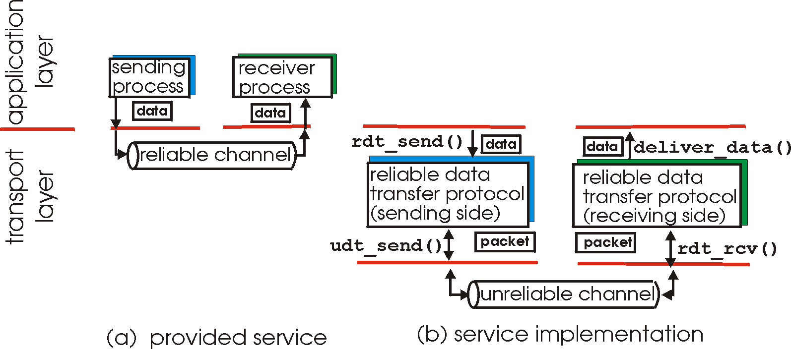
Principles of reliable data transfer
important in application, transport, link layers
top-10 list of important networking topics!
characteristics of unreliable channel will determine complexity of reliable data transfer protocol (rdt)

Slide 7
Principles of reliable data transfer
important in application, transport, link layers
top-10 list of important networking topics!
characteristics of unreliable channel will determine complexity of reliable data transfer protocol (rdt)

Slide 8

Stop-and-wait with lost packet/frame
sender
receiver
sender
receiver
send pkt0
pkt0
send pkt0
pkt0
rcv pkt0
rcv pkt0
ack0
send ack0
ack0
send ack0
rcv ack0
rcv ack0
send pkt1
pkt1
send pkt1
pkt1
rcv pkt1
X
ack1
send ack1
loss
rcv ack1
send pkt0
pkt0
rcv pkt0
timeout
resend pkt1
ack0
send ack0
pkt1
rcv pkt1
ack1
send ack1
rcv ack1
send pkt0
pkt0
(a) no loss
rcv pkt0
ack0
send ack0
(b) packet loss

Slide 9
sender
receiver
sender
receiver
send pkt0
pkt0
send pkt0
pkt0
rcv pkt0
rcv pkt0
ack0
send ack0
send ack0
rcv ack0
ack0
send pkt1
pkt1
rcv ack0
rcv pkt1
send pkt1
pkt1
send ack1
rcv pkt1
ack1
send ack1
ack1
X
loss
timeout
resend pkt1
pkt1
rcv pkt1
timeout
resend pkt1
rcv ack1
pkt1
rcv pkt1
pkt0
(detect duplicate)
send pkt0
send ack1
ack1
(detect duplicate)
ack1
rcv pkt0
rcv ack1
send ack1
rcv ack1
ack0
send ack0
pkt0
send pkt0
pkt0
send pkt0
rcv pkt0
rcv pkt0
ack0
(detect duplicate)
ack0
send ack0
send ack0
(c) ACK loss
(d) premature timeout/ delayed ACK

Slide 10
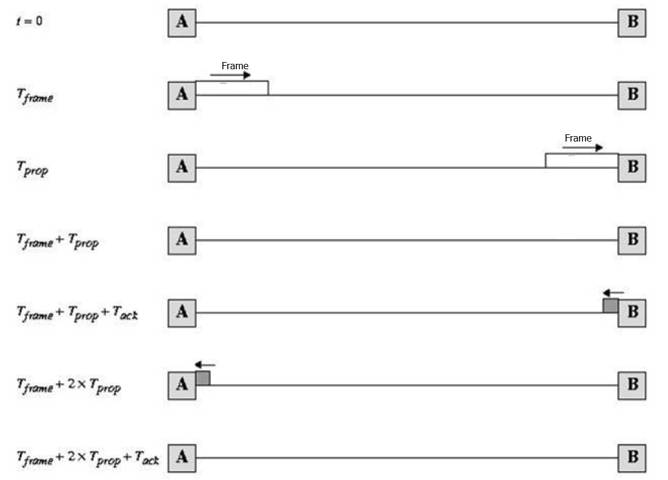
Stop-and-wait link utilization

Slide 11
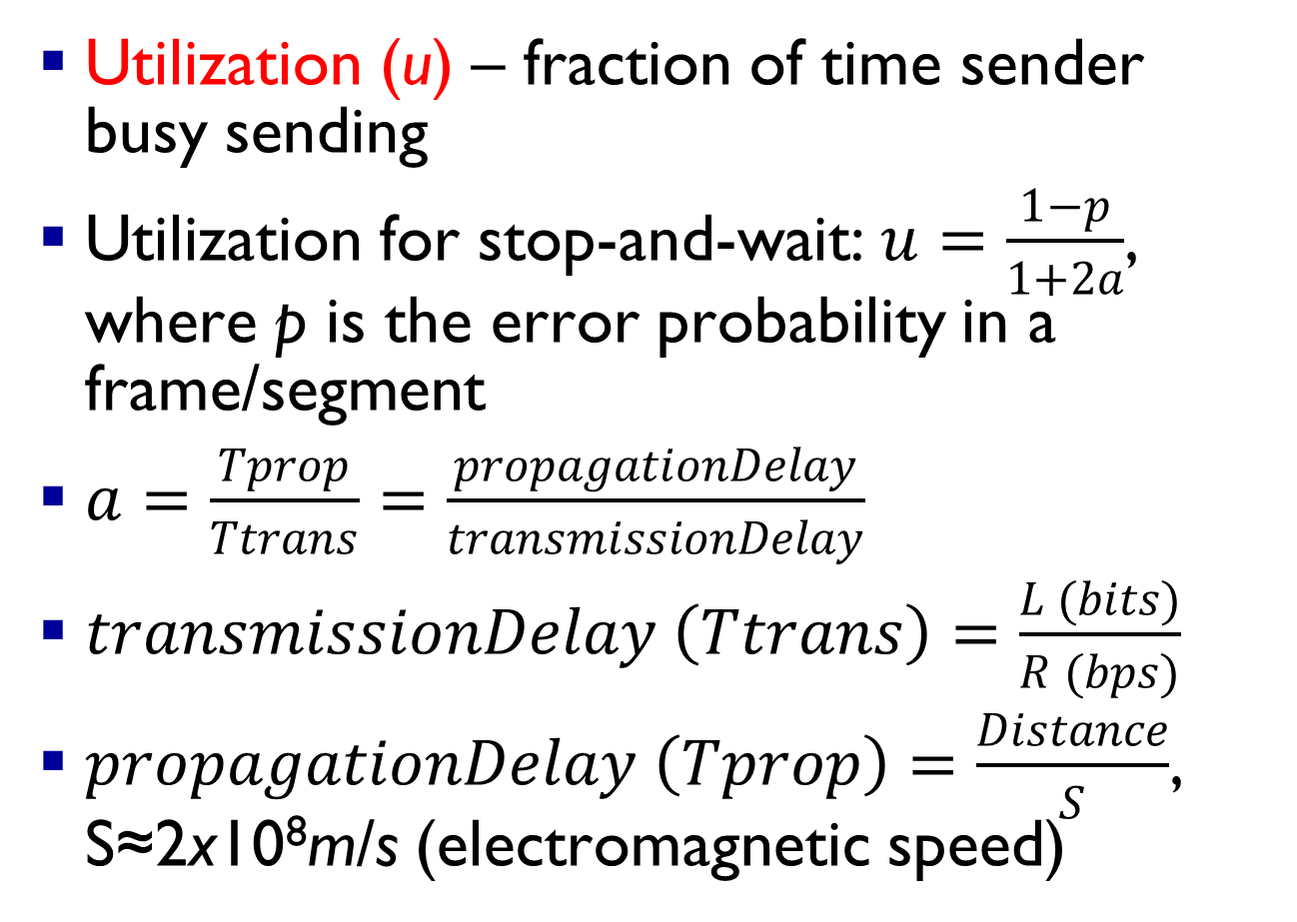
Utilization (u) – fraction of time sender busy sending
Utilization for stop-and-wait: $u=\frac{1−p}{1+2a}$, where p is the error probability in a frame/segment
$a=\frac{Tprop}{Ttrans}=\frac{propagationDelay}{transmissionDelay}$
$transmissionDelay \left(Ttrans\right)=\frac{L (bits)}{R (bps)}$
$propagationDelay \left(Tprop\right)=\frac{Distance}{S}$, S≈2x10⁸m/s (electromagnetic speed)

Slide 12
stop-and-wait operation
sender
receiver
first packet bit transmitted, t = 0
last packet bit transmitted, t = L / R
first packet bit arrives
RTT
last packet bit arrives, send ACK
ACK arrives, send next
packet, t = RTT + L / R

Slide 13
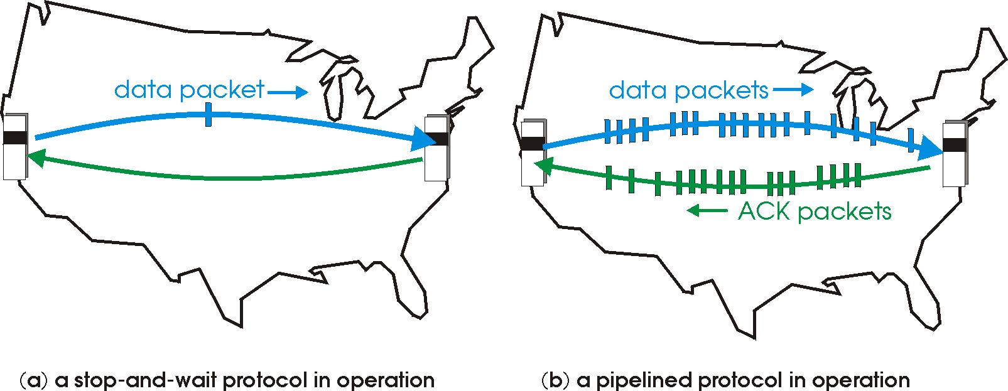

Pipelined (sliding window) protocols
pipelining: sender allows multiple, “in-flight”, yet-to-be-acknowledged pkts
range of sequence numbers must be increased
buffering at sender and/or receiver
two generic forms of pipelined protocols: go-Back-N, selective repeat

Slide 14
Pipelining: increased utilization
sender
receiver
first packet bit transmitted, t = 0
last bit transmitted, t = L / R
first packet bit arrives
RTT
last packet bit arrives, send ACK
last bit of 2nd packet arrives, send ACK
last bit of 3rd packet arrives, send ACK
ACK arrives, send next
packet, t = RTT + L / R
3-packet pipelining increases
utilization by a factor of 3!

Slide 15
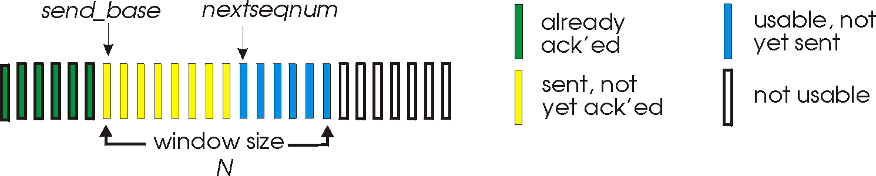
Go-Back-N: sender
k-bit seq # in pkt header
“window” of up to N, consecutive unack’ed pkts allowed
ACK(n): ACKs all pkts up to, including seq # n - “cumulative ACK”
may receive duplicate ACKs (see receiver)
timer for oldest in-flight pkt
timeout(n): retransmit packet n and all higher seq # pkts in window

Slide 16
GBN in action
sender window (N=4)
sender
receiver
0 1 2 3 4 5 6 7 8
send pkt0
send pkt1
send pkt2
send pkt3
(wait)
0 1 2 3 4 5 6 7 8
receive pkt0, send ack0
receive pkt1, send ack1
receive pkt3, discard,
(re)send ack1
0 1 2 3 4 5 6 7 8
X
0 1 2 3 4 5 6 7 8
loss
0 1 2 3 4 5 6 7 8
rcv ack0, send pkt4
rcv ack1, send pkt5
0 1 2 3 4 5 6 7 8
receive pkt4, discard,
(re)send ack1
ignore duplicate ACK
receive pkt5, discard,
(re)send ack1
pkt 2 timeout
0 1 2 3 4 5 6 7 8
send pkt2
send pkt3
send pkt4
send pkt5
0 1 2 3 4 5 6 7 8
0 1 2 3 4 5 6 7 8
rcv pkt2, deliver, send ack2
rcv pkt3, deliver, send ack3
rcv pkt4, deliver, send ack4
rcv pkt5, deliver, send ack5
0 1 2 3 4 5 6 7 8

Slide 17
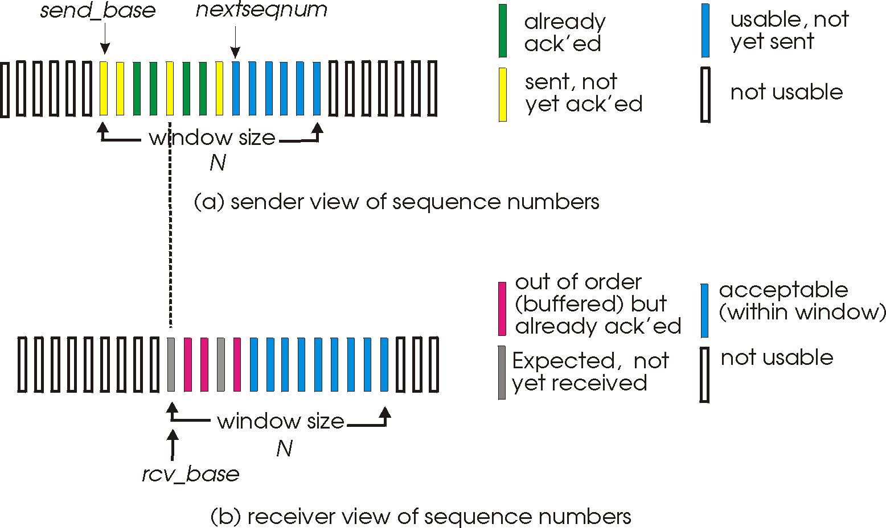
Selective repeat: sender, receiver windows

Slide 18
Selective repeat in action
sender window (N=4)
sender
receiver
0 1 2 3 4 5 6 7 8
send pkt0
send pkt1
send pkt2
send pkt3
(wait)
0 1 2 3 4 5 6 7 8
receive pkt0, send ack0
receive pkt1, send ack1
receive pkt3, buffer,
send ack3
0 1 2 3 4 5 6 7 8
X
0 1 2 3 4 5 6 7 8
loss
0 1 2 3 4 5 6 7 8
rcv ack0, send pkt4
rcv ack1, send pkt5
0 1 2 3 4 5 6 7 8
receive pkt4, buffer,
send ack4
record ack3 arrived
receive pkt5, buffer,
send ack5
pkt 2 timeout
0 1 2 3 4 5 6 7 8
send pkt2
0 1 2 3 4 5 6 7 8
record ack4 arrived
0 1 2 3 4 5 6 7 8
rcv pkt2; deliver pkt2,
pkt3, pkt4, pkt5; send ack2
record ack5 arrived
0 1 2 3 4 5 6 7 8
Q: what happens when ack2 arrives?

Slide 19

Selective repeat:
$u=(1−p)$, if w fills the pipe,
otherwise $u=\frac{w(1−p)}{1+2a}$
where p is segment error rate

Slide 20
practical case: finite buffers, loss
Phase 1: no congestion: near ideal performance
Phase II : overall moderate congestion:
severe congestion in some nodes
dynamics of the network/routing and overhead of protocol adaptation decreases the network Tput
Phase III: severe congestion:
loss of packets and increased discards
extended delays leading to timeouts
both factors trigger re-transmissions
leads to chain-reaction bringing the Tput down

Slide 21
(I)
(II)
(III)
(I) No Congestion
(II) Moderate Congestion
(III) Severe Congestion (Collapse)
What is the best operational point and how do we get (and stay) there?

Slide 23
Reliability in TCP
Components of reliability
1. Sequence numbers
2. Retransmissions
3. Timeout Mechanism(s): function of the round trip time (RTT) between the two hosts (is it static?)

Slide 24
TCP round trip time, timeout
EstimatedRTT(k)=(1- α)*EstimatedRTT(k-1)+ α*SampleRTT(k)
=(1- α)*((1- α)*EstimatedRTT(k-2)+ α*SampleRTT(k-1))+ α *SampleRTT(k)
=(1- α)^{k} *SampleRTT(0)+ α(1- α)^{k-1} *SampleRTT)(1)+…+ α *SampleRTT(k)
exponentially-weighted moving average (EWMA)
influence of past sample decreases exponentially fast
typical value: α = 0.125
RTT: gaia.cs.umass.edu to fantasia.eurecom.fr
RTT (milliseconds)
sampleRTT
EstimatedRTT
time (seconds)

Slide 25

TCP round trip time, timeout
timeout interval: EstimatedRTT plus “safety margin”
large variation in EstimatedRTT -> larger safety margin
1. estimate SampleRTT deviation from EstimatedRTT:
DevRTT = (1-β)*DevRTT +
β*|SampleRTT-EstimatedRTT|
(typically, β = 0.25)
2. set timeout interval:
TimeoutInterval = EstimatedRTT + 4*DevRTT
estimated RTT
“safety margin”
3. for further re-transmissions (if the 1st re-tx was not Ack’ed)
- RTO=q.RTO, q=2 for exponential backoff
- similar to Ethernet CSMA/CD backoff
* Check examples: http://gaia.cs.umass.edu/kurose_ross/interactive/

Slide 26
TCP fast retransmit
time-out period often relatively long:
long delay before resending lost packet
detect lost segments via duplicate ACKs.
sender often sends many segments back-to-back
if segment is lost, there will likely be many duplicate ACKs.
TCP fast retransmit
if sender receives 3 ACKs for same data
(“triple duplicate ACKs”), resend unacked segment with smallest seq # to avoid timeout
likely that unacked segment lost, so don’t wait for timeout
(“triple duplicate ACKs”),

Slide 27

TCP flow control
application
process
application may
remove data from
TCP socket buffers ….
application
TCP socket
receiver buffers
OS
… slower than TCP
receiver is delivering
(sender is sending)
TCP
code
flow control
IP
code
receiver controls sender, so sender won’t overflow receiver’s buffer by transmitting too much, too fast
from sender
receiver protocol stack

Slide 28
TCP flow control
receiver “advertises” free buffer space by including rwnd (RcvWindow) value in TCP header of receiver-to-sender segments
RcvBuffer size set via socket options (typical default is 4096 bytes)
many operating systems autoadjust RcvBuffer
sender limits amount of unacked (“in-flight”) data to receiver’s rwnd value
guarantees receive buffer will not overflow
to application process
RcvBuffer
buffered data
rwnd
free buffer space
TCP segment payloads
receiver-side buffering
match the send rate to the receiving app’s drain rate

Slide 29
TCP congestion control: additive increase multiplicative decrease (AIMD)
approach: sender increases transmission rate (window size), probing for usable bandwidth, until loss occurs
additive increase: increase congestion window (cwnd) by 1 segment (max segment size MSS) every RTT until loss detected
multiplicative decrease: cut cwnd in half after loss
additively increase window size …
…. until loss occurs (then cut window in half)
AIMD saw tooth
behavior: probing
for bandwidth
cwnd: TCP sender
congestion window size
time

Slide 30
TCP Congestion Control: details
How does sender perceive congestion?
loss event = timeout or duplicate Acks
TCP sender reduces rate (CongWin) after loss event
Is loss always due to congestion? And is reducing the rate always the optimal response to loss?! [hint: think wirelss!]
How is the rate reduced?
- Three mechanisms for window management:
AIMD
slow start
conservative after timeout events

Slide 31
TCP window management
At any time the allowed window (awnd): awnd=min[rwnd, cwnd],
where rwnd is given by the receiver (i.e., Receive Window) and cwnd is the congestion window
Slow-start algorithm:
start with cwnd=1, then
cwnd=CongWin+1 with every ‘Ack’
This leads to ‘doubling’ of the CongWin with RTT; i.e., exponential increase

Slide 32
TCP: detecting, reacting to loss
Initially slow start: cwnd=cwnd+1 with every Ack
loss indicated by timeout (congestion avoidance):
threshold ssthresh=cwnd/2; cwnd =1 MSS;
cwnd grows exponentially (slow start) to ssthresh
then grows linearly: cwnd=cwnd+1 with every RTT, or cwnd=cwnd+1/cwnd for every Ack
Additive increase, multiplicative decrease (AIMD)
loss indicated by 3 duplicate Acks: TCP RENO
dup ACKs indicate network capable of delivering some segments (non-severe congestion)
cwnd is cut in half window then grows linearly
TCP Tahoe always sets cwnd=1 (timeout or 3 dup Acks)

Slide 34
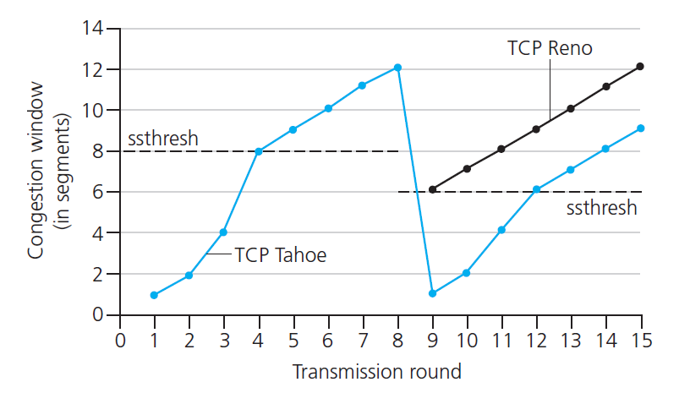
TCP: switching from slow start to CA
Q: when should the exponential increase switch to linear?
A: when cwnd gets to 1/2 of its value before timeout.
Implementation:
variable ssthresh
on loss event, ssthresh is set to 1/2 of cwnd just before loss event
* Check interactive exercises : http://gaia.cs.umass.edu/kurose_ross/interactive/

Slide 35
Fast Retransmit & Recovery
Fast retransmit:
receiver sends Ack with last in-order segment for every out-of-order segment received
when sender receives 3 duplicate Acks it retransmits the missing/expected segment
Fast recovery: when 3rd dup Ack arrives
ssthresh=cwnd/2
retransmit segment, set cwnd=ssthresh+3
for every duplicate Ack: cwnd=cwnd+1
(note: beginning of window is ‘frozen’)
after receiver gets cumulative Ack: cwnd=ssthresh
(beginning of window advances to last Ack’ed segment)
cwnd

Slide 37
TCP throughput
avg. TCP thruput as function of window size, RTT?
ignore slow start, assume always data to send
W: window size (measured in bytes) where loss occurs
avg. window size (# in-flight bytes) is ¾ W
avg. thruput is 3/4W per RTT
avg TCP thruput =
3
W
4
RTT
bytes/sec
W
W/2

Slide 38
TCP Futures: TCP over “long, fat pipes”
example: 1500 byte segments, 100ms RTT, want 10 Gbps throughput
requires W = 83,333 in-flight segments
throughput in terms of segment loss probability, L [Mathis 1997]:
➜ to achieve 10 Gbps throughput, need a loss rate of L = 2·10⁻¹⁰ – a very small loss rate!
new versions of TCP for high-speed
1.22
.
MSS
TCP throughput =
RTT
L

Slide 39
TCP Fairness
fairness goal: if K TCP sessions share same bottleneck link of bandwidth R, each should have average rate of R/K
TCP connection 1
bottleneck
router
capacity R
TCP connection 2

Slide 40
Fairness (more)
Fairness and UDP
multimedia apps often do not use TCP
do not want rate throttled by congestion control
instead use UDP:
send audio/video at constant rate, tolerate packet loss
Fairness, parallel TCP connections
application can open multiple parallel connections between two hosts
web browsers do this
e.g., link of rate R with 9 existing connections:
new app asks for 1 TCP, gets rate R/10
new app asks for 11 TCPs, gets R/2

Slide 41
Explicit Congestion Notification (ECN)
network-assisted congestion control:
two bits in IP header (ToS field) marked by network router to indicate congestion
congestion indication carried to receiving host
receiver (seeing congestion indication in IP datagram) ) sets ECE (ECN Echo) bit on receiver-to-sender ACK segment to notify sender of congestion
source
TCP ACK segment
destination
application
transport
network
link
physical
ECE=1
application
transport
network
link
physical
ECN=00
ECN=11
IP datagram

